Slide 1
Introduction to Information and Communication Technologies
Lecture Week 1

Slide 2
Course Details & Grading Criteria
Week | Topic
1 | Introduction
2 | Number System
3 | Computer Organization
4 | Mathematics in Computer Science
5 | Operating systems
6 | Data Management and its applications
7 | Computer Graphics
8 | Communication
9 | Web development
10 | Artificial Intelligence
11 | Big data
12, 13, 14 | Student Presentations
 | FINAL EXAM
Weekly Activities + Attendance 25%
Final Presentation 25%
Exam 50%

Slide 3
What are ICT?
Information
Communication
Technologies
ICT are the hardware and software that enable society to create, collect, consolidate and communicate information in different formats and for various purposes.
The technology used to handle information and aid communication

Slide 4

Do you use ICT

Slide 5
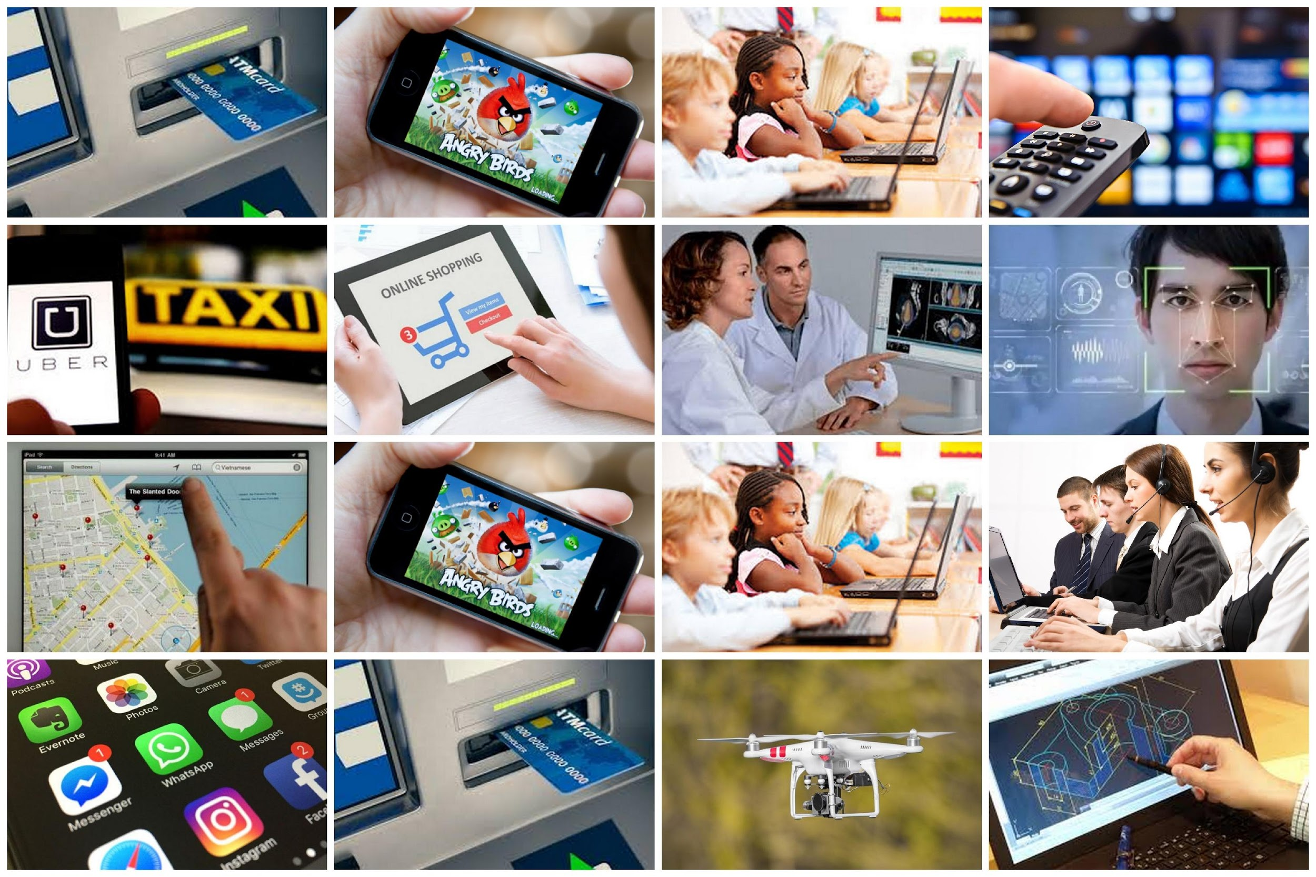

Slide 6
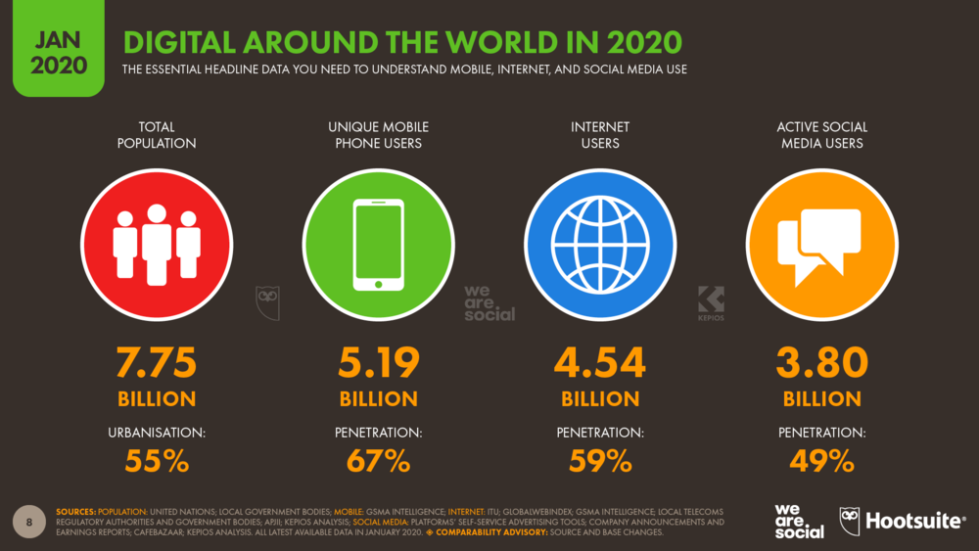
Amazing Facts and Statistics

Slide 7
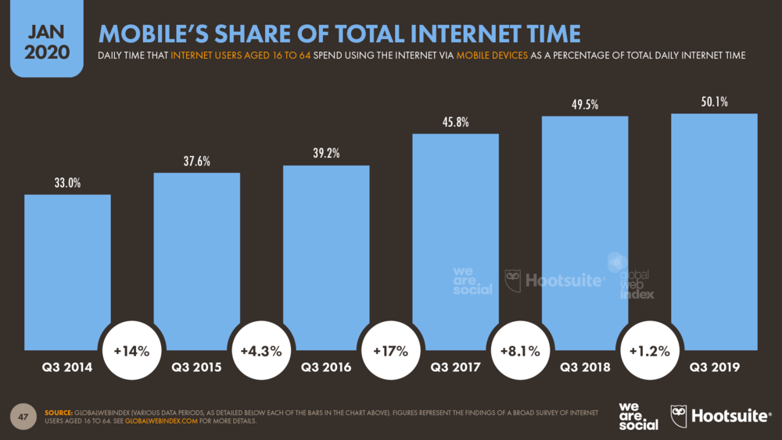
Amazing Facts and Statistics

Slide 8
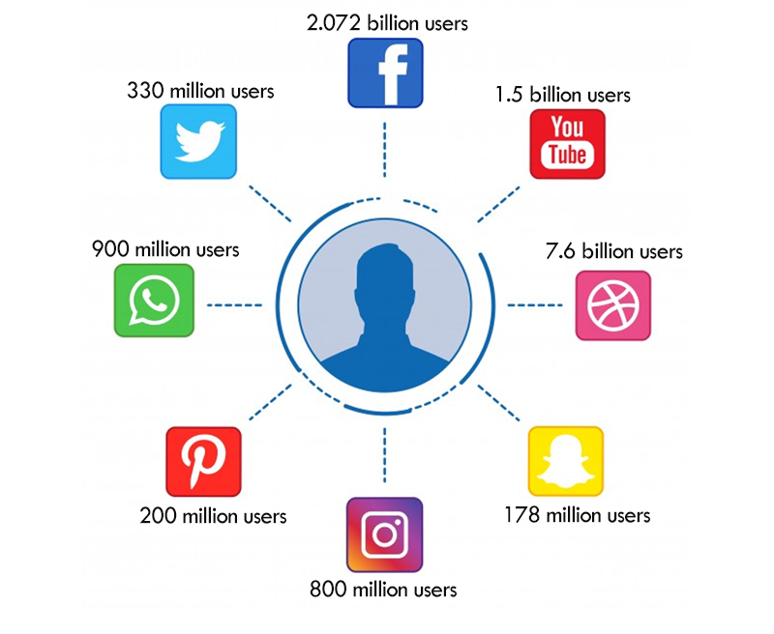
Amazing Facts and Statistics

Slide 9
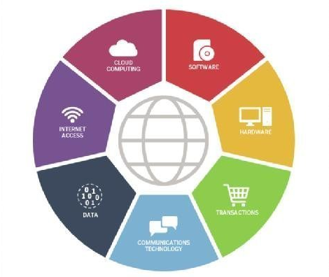
Components of ICT

Slide 10
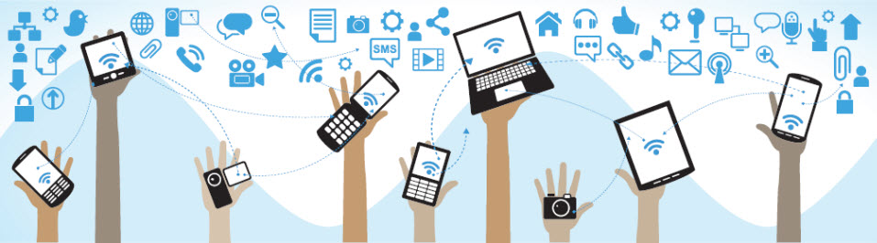
Information & Communication Devices
Computers
Mobile phones
Cameras
Gaming consoles
Home entertainment Systems

Slide 11
Information & Communication Software
Spreadsheet programs (such as MS Excel)
Word Processor (such as MS Word)
Web Browser
Skype
Home entertainment Systems

Slide 12
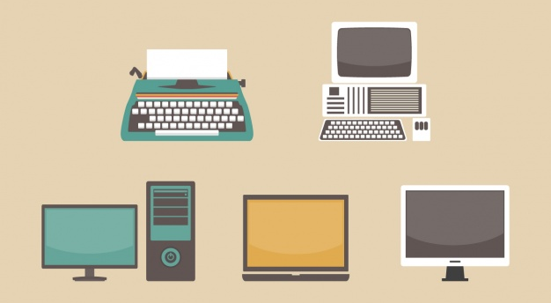
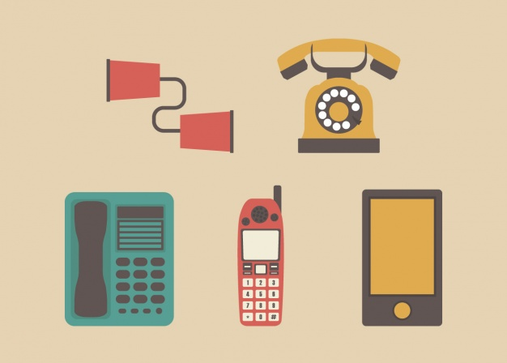
Device Evolution

Slide 13
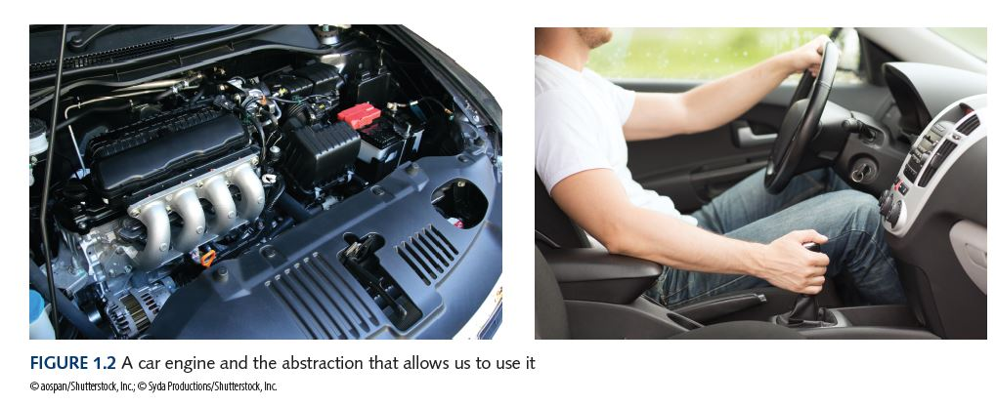
Internal and Abstract View

Slide 14
Impact of ICT on society
Developments in ICT have brought about the merger of
the computing,
information,
communications,
entertainment,
mass media industries
thereby providing a means of exchanging information in the digital format used by computers.

Slide 15


Transition
Shift from Print to Digital
Internet
Innovations in ICT have made the transfer of digital information from remote sites possible

Slide 16
Few Basics
Computers
A computer is an electronic machine that has the capability to perform certain types of processing/computation on the supplied data. It can also store the data as well as generated results.
Processing/
Computation
Data & Instructions
Information/Results
Storage

Slide 17
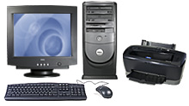
Few Basics
Computers
Device that accepts input, process and stores data, and gives output
Device that can execute specific set of instructions in a well-defined manner

Slide 18
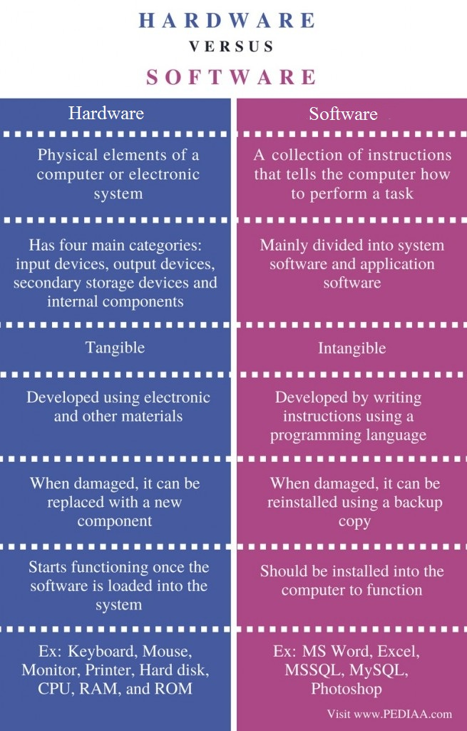
Difference between Hardware & Software?

Slide 19
Application Software vs System Software
System Software | Application Software
System software controls hardware. | Application software fulfils user requests
Acts as an interface between hardware and application software | Runs on the platform provided by system software
Examples include, Operating Systems, device drivers, etc. | Word processors, media players, etc.

Slide 20
Few Basics….
Computer
Hardware
Software
CPU
Memory
I/O
Etc.
Application
Software
System
Software

Slide 21
Few Basics
Computer Hardware
Electric, electronic, and mechanical devices
Computer Software
Programs and data in electronic form on a storage medium
Program- Sequence of Instructions

Slide 22
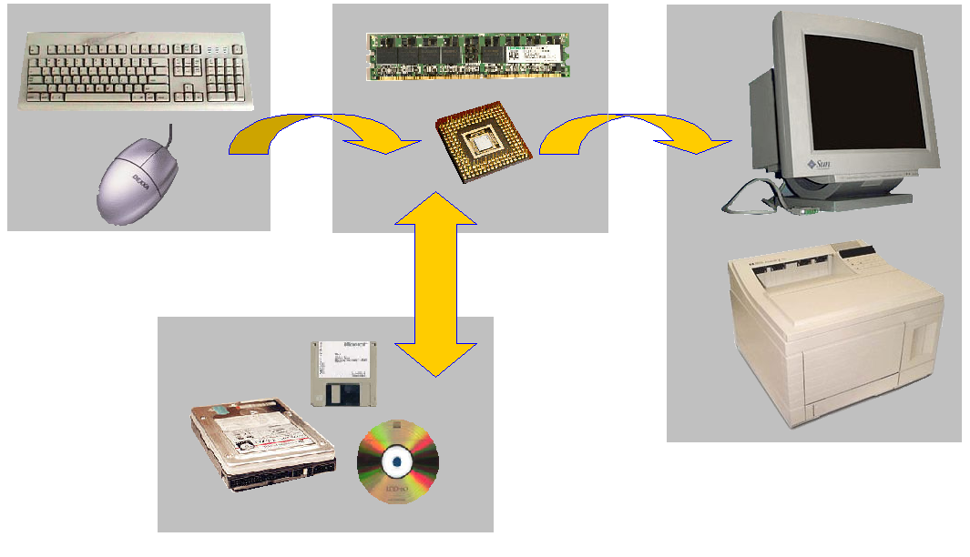
Few Basics: Hardware

Slide 23
Few Basics
Input devices
Processor & Memory
Storage devices
Output devices

Slide 24
Few Basics: Input Devices
Mouse
Keyboard
Joystick
Camera
Microphone

Slide 25
Few Basics : Output Devices
Peripheral Devices:
Printer - laser, inkjet, dotmatrix
Plotter - flatbed, drum
Speakers
Monitor - CRT, LCD, projector
Notes:
CRT Monitors Sort for cathode-ray tubes, CRT monitors were the only choice consumers had for monitor technology for many years. Cathode ray tube (CRT) technology has been in use for more than 100 years, and is found in most televisions and computer monitors. A CRT works by moving an electron beam back and forth across the back of the screen. Each time the beam makes a pass across the screen, it lights up phosphor dots on the inside of the glass tube, thereby illuminating the active portions of the screen. By drawing many such lines from the top to the bottom of the screen, it creates an entire screen of images.
LCD/Flat panel Monitors Short for liquid crystal display, LCD technology can be found in digital watches and computer monitors. LCD displays use two sheets of polarizing material with a liquid crystal solution between them. An electric current passed through the liquid causes the crystals to align so that light cannot pass through them. Each crystal, therefore, is like a shutter, either allowing light to pass through or blocking the light. Color LCD displays use two basic techniques for producing color: Passive matrix is the less expensive of the two technologies. The other technology, called thin film transistor (TFT) or active-matrix, produces color images that are as sharp as traditional CRT displays, but the technology is expensive

Slide 26
Few Basics : Processor/CPU
Pentium
8086
Celeron
SPARC
Alpha
What are Control Unit and ALU?
The arithmetic/logic unit (ALU) contains the electronic circuitry that executes all arithmetic and logical operations.
The control unit (CU) of the CPU contains circuitry that uses electrical signals to direct the entire computer system to carry out, or execute, stored program instructions.

Slide 27

History

Slide 28
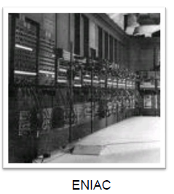
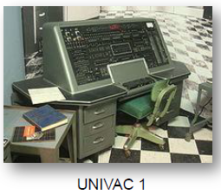
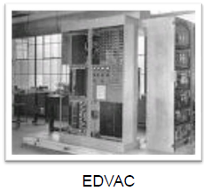
Early History of Computing
ENIAC, UNIVAC I
ENIAC first electronic general purpose computer
Early computers launch new era in mathematics, physics, engineering and economics
7

Slide 29
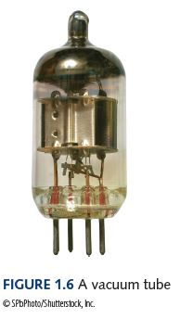
First Generation Hardware (1951-1959)
Vacuum Tubes - circuitry
Large, not very reliable, generated a lot of heat
Magnetic Drum - memory
Memory device that rotated under a read/write head
Card Readers 🡪 Magnetic Tape Drives
Sequential auxiliary storage devices
Computers relied on machine language, input was based on punch cards and paper tape, output displayed on printouts
8

Slide 30
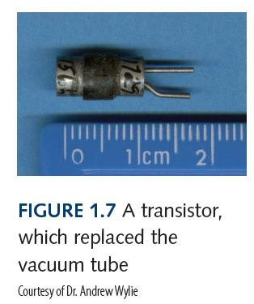
Second Generation Hardware (1959-1965)
Transistor
Replaced vacuum tube (1-40), fast, small, durable, cheap
Magnetic Cores
Replaced magnetic drums, information available instantly
Magnetic Disks
Replaced magnetic tape, data can be accessed directly
Computers relied on symbolic/assembly language
9

Slide 31
Third Generation Hardware And Computers (1965-1971)
Integrated Circuits
Replaced circuit boards, smaller, cheaper, faster, more reliable
Transistors
Now used for memory construction
Terminal
An input/output device with a keyboard and screen
Third-generation languages (3GLs) are high-level programming languages, such as FORTRAN, COBOL, BASIC, Pascal, C/C++ and Java.
10

Slide 32
Fourth Generation Hardware (1971-?)
Large-scale Integration
Great advances in chip technology, microprocessor (thousands of ICs on single chip)
PCs, the Commercial Market, Workstations
Personal Computers and Workstations emerge
New companies emerge: Apple, Sun, Dell …
Laptops, Tablet Computers, and Smart Phones
Everyone has his/her own portable computer
Everyone has his/her own portable computer languages that consist of statements similar to statements in a human language. Fourth generation languages are commonly used in database programming and scripts examples include Perl, PHP, Python, Ruby, and SQL.
10

Slide 33
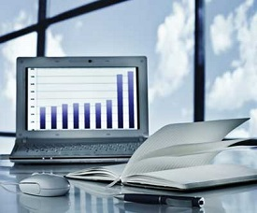
Computer Applications
Business
Payroll calculations
E-Commerce
Sales analysis
Managing employees record
Stock maintenance

Slide 34
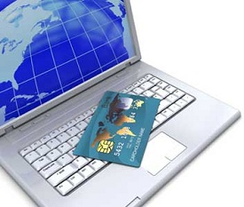
Computer Applications
Banking
Online banking (checking balance, funds transfer etc.)
ATM (automated teller machine)

Slide 35
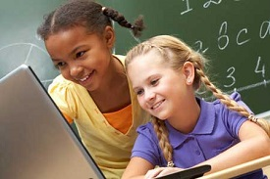
Computer Applications
Education
The computer provides a tool in the education system known as CBE (Computer Based Education).
CBE involves control, delivery, and evaluation of learning.
Computer education is rapidly increasing the graph of number of computer students.
There are a number of methods in which educational institutions can use a computer to educate the students.
It is used to prepare a database about performance of a student and analysis is carried out on this basis.

Slide 36
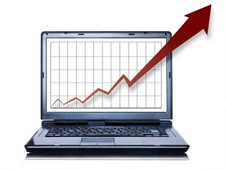
Computer Applications
Marketing
Advertising − With computers, advertising professionals create art and graphics, write and revise copy, and print and disseminate ads with the goal of selling more products.
Home Shopping − Home shopping has been made possible through the use of computerized catalogues that provide access to product
information and permit direct entry
of orders to be filled by the customers.

Slide 37

Computer Applications
Healthcare
Diagnostic System − Computers are used to collect data and identify the cause of illness.
Lab-diagnostic System − All tests can be done and the reports are prepared by computers.
Patient Monitoring System − These are used to check the patient's signs for abnormality such as in Cardiac Arrest, ECG, etc.
Pharma-Information System − Computer is used to check drug labels, expiry dates, harmful side effects, etc.
Surgery − Nowadays, computers are also used in performing surgery.

Slide 38
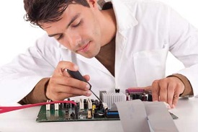
Computer Applications
Engineering Design
Structural Engineering − Requires stress and strain analysis for design of ships, buildings, budgets, airplanes, etc.
Industrial Engineering − Computers deal with design, implementation, and improvement of integrated systems of people, materials, and equipment.
Architectural Engineering − Computers help in planning towns, designing
buildings, determining a range of
buildings on a site using both 2D
and 3D drawings.

Slide 39
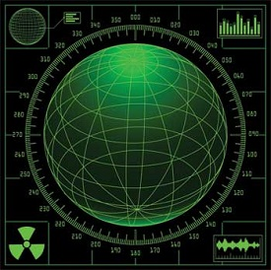
Computer Applications
Military
Missile Control
Military Communication
Military Operation and Planning
Smart Weapons

Slide 40

Computer Applications
Communication
E-mail
Chatting
FTP
Video-conferencing
Web-browsing

Slide 41
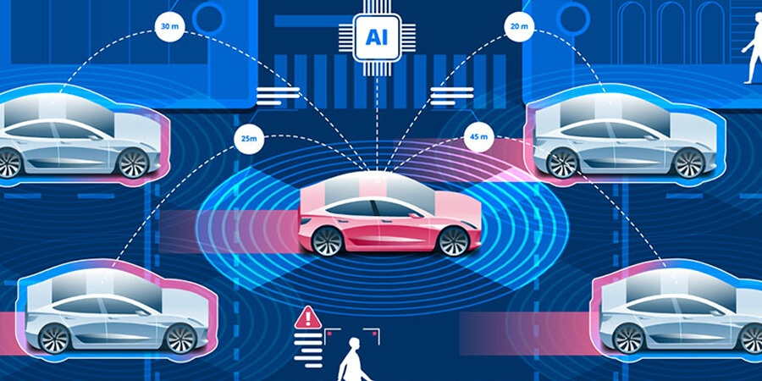
Computer Applications
Transport
Flying (Fly-by-Wire, autopilot)
Self-driving cars
GPS Navigation
Online booking (uber, careem, etc.)

Slide 42
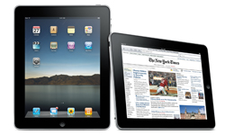
Types of Computer
PC (Personal Computer )
Small
Inexpensive
Business Use
Word processing, running spreadsheets etc.
Personal Use
Playing games, surfing the internet, movies, games etc.
Single user system

Slide 43
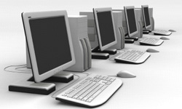
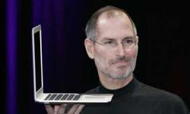
Types of Computer
Desktop
PC not designed for portability
More storage and computation with less cost
Laptop (notebook)
Portable with integrated display
Battery operated

Slide 44
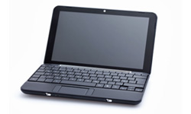
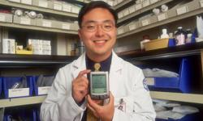
Types of Computer
Netbook
Smaller and cheaper than laptops
Less powerful than laptop
PDA (personal digital assistant)
Tightly integrated computer
Flash memory instead of hard disk
Touch screen instead of keyboard
Lightweight and reasonable battery life

Slide 45
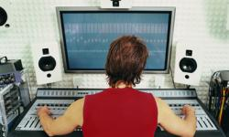
Types of Computer
Workstation
Desktop computer with more processing power
More memory
More capabilities in performing specialized tasks

Slide 46
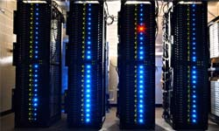
Types of Computer
Server
Computer that serves other computers over network
More processing power, memory and storage
Large in size

Slide 47
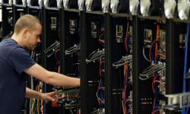
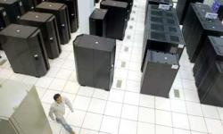
Types of Computer
Mainframe
Very large size
Now known as enterprise server
More processing power
Supercomputer
Very expensive
Fastest computers
Employed for specific applications which require immense amount of calculations
weather forecasting
scientific simulations
(animated) graphics
nuclear energy research
electronic design

Slide 48
Activity
Discuss at least 3 types of equipment or machines that use a computer. Also explain the purpose of the computer in that machine or equipment.
Discuss all digital devices that you own, such as laptop, mobile, smart watch, etc. and explain their unique functionalities.

Slide 49
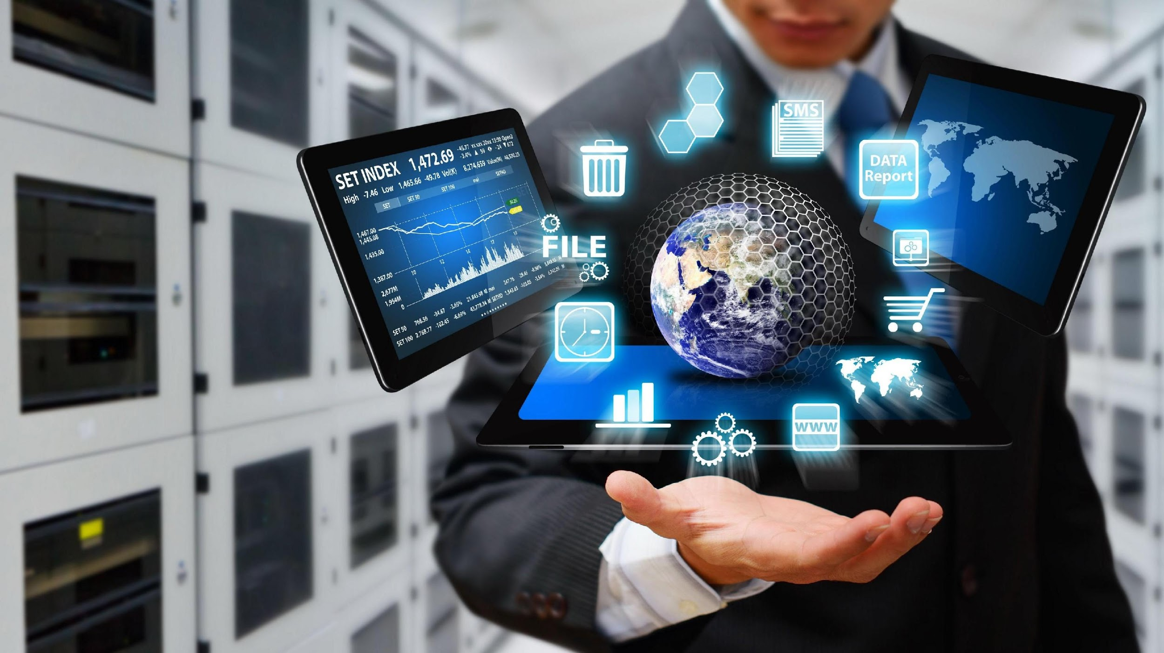
Thank You

